Slide 1


7
Group 7
Predict Credit Card Default Rate with Classification Methods
Instructor: 盧子彬
Group 7 Team members: 余奇祐、黃慶杰

Slide 2


Outline
A
Data Introduction and management
B
Support Vector Machine (SVM)
Modeling
Comparisons
Results
C
Classification And Regression Tree (CART)
Modeling
Comparisons
Results
D
Conclusion and Discussion

Slide 3


Introduction
• • • • •
SVM
• • • • •
CART
••••
Conclusion
• •
Data Introduction
ABOUT DATA
From UCI dataset
Default of credit card clients data set in 2006
23 explanatory variables with 30,000 records
04

Slide 4

Introduction
• • • • •
SVM
• • • • •
CART
••••
Conclusion
• •
Data Management
Variables
Amount of the given credit (individual consumer and his/her family)
Gender (1 = male; 2 = female)
Education (1 = graduate school; 2 = university; 3 = high school; 4 = others)
Marital status (1 = married; 2 = single; 3 = others)
Age (year)
Basic information

Slide 5

Introduction
• • • • •
SVM
• • • • •
CART
••••
Conclusion
• •
Data Management
Variables
The repayment status from April to September in 2005
→ sum positive months
Amount of bill statement from April to September in 2005
→ max amount of bill statement
Amount paid from April to September in 2005
→ max amount paid
Recoded variables

Slide 6

Introduction
• • • • •
SVM
• • • • •
CART
••••
Conclusion
• •
Data Management
Variables
The repayment status from April to September in 2005
Amount of bill statement from April to September in 2005
Amount paid from April to September in 2005
PC 1

Slide 7
Introduction
• • • • •
SVM
• • • • •
CART
••••
Conclusion
• •
Data Management
Basic
information
Recoded
variables
Data Set A
Basic
information
Data Set B
PC 1

Slide 8

Introduction
• • • • •
SVM
• • • • •
CART
••••
Conclusion
• •
Compare two datasets:
Data set A (recoded variables)
Data set B (PC 1)
Compare four kernels:
Linear
Polynomial
Radial
Sigmoid
10-fold cross-validation accuracy rate
SVM – Modeling

Slide 9





Loading……
1%
2%
3%
4%
5%
6%
7%
8%
9%
10%
11%
12%
13%
14%
15%
16%
17%
18%
19%
20%
21%
22%
23%
24%
25%
26%
27%
28%
29%
30%
31%
32%
33%
34%
35%
36%
37%
38%
39%
40%
41%
42%
43%
44%
45%
46%
47%
48%
49%
50%
51%
52%
53%
54%
55%
56%
57%
58%
59%
60%
61%
62%
63%
64%
65%
66%
67%
68%
69%
70%
71%
72%
73%
74%
75%
76%
77%
78%
79%
80%
81%
82%
83%
84%
85%
86%
87%
88%
89%
90%
91%
92%
93%
94%
95%
96%
97%
98%
99%
100%

Slide 10


Website: https://www.youtube.com/watch?v=3liCbRZPrZA

Slide 11

Introduction
• • • • •
SVM
• • • • •
CART
••••
Conclusion
• •
SVM – Comparisons
10-fold cross-validation accuracy rate
Data set A is better than Data set B.
Sigmoid performed worst.
 | Linear | Polynomial | Radial | Sigmoid
Data set A | 80.37% | 80.34% | 80.39% | 71.73%
Data set B | 77.88% | 77.88% | 77.88% | 65.69%

Slide 12

Introduction
• • • • •
SVM
• • • • •
CART
••••
Conclusion
• •
SVM – Comparisons
Running time
Linear spent the least time.
 | Linear | Polynomial | Radial | Sigmoid
Data set A | 8.29 mins | 10.67 mins | 29.89 mins | 10.11 mins
Data set B | 3.44 mins | 1.39 hours | 25.14 mins | 12.89 mins

Slide 13
Introduction
• • • • •
SVM
• • • • •
CART
••••
Conclusion
• •
PART ONE
SVM
SVM – Results
Based on the 10-fold cross-validation accuracy rate
and running time, SVM with linear kernel applying to
Data set A may be preferable.

Slide 14
Introduction
• • • • •
SVM
• • • • •
CART
••••
Conclusion
• •
CART – Modeling
2. Compare tree with random forest:
Tree: minbucket = 100
and maxdepth = 5
Random forest: number of
tree = 500
and number of variable = 3
Compare two datasets:
Data set A
(recoded variables)
Data set B (PC 1)
3. 10-fold cross-validation accuracy rate
22

Slide 15
Introduction
• • • • •
SVM
• • • • •
CART
••••
Conclusion
• •
CART – Comparisons
10-fold cross-validation accuracy rate
Data set A is better than Data set B.
Tree is better than random forest.
 | Tree | Random forest
Data set A | 80.46% | 79.98%
Data set B | 77.88% | 76.35%

Slide 16
Introduction
• • • • •
SVM
• • • • •
CART
••••
Conclusion
• •
CART – Comparisons
Running time
Tree computed faster than
random forest.
 | Tree | Random forest
Data set A | 5.33 secs | 3.47 mins
Data set B | 1.38 secs | 3.14 mins

Slide 17
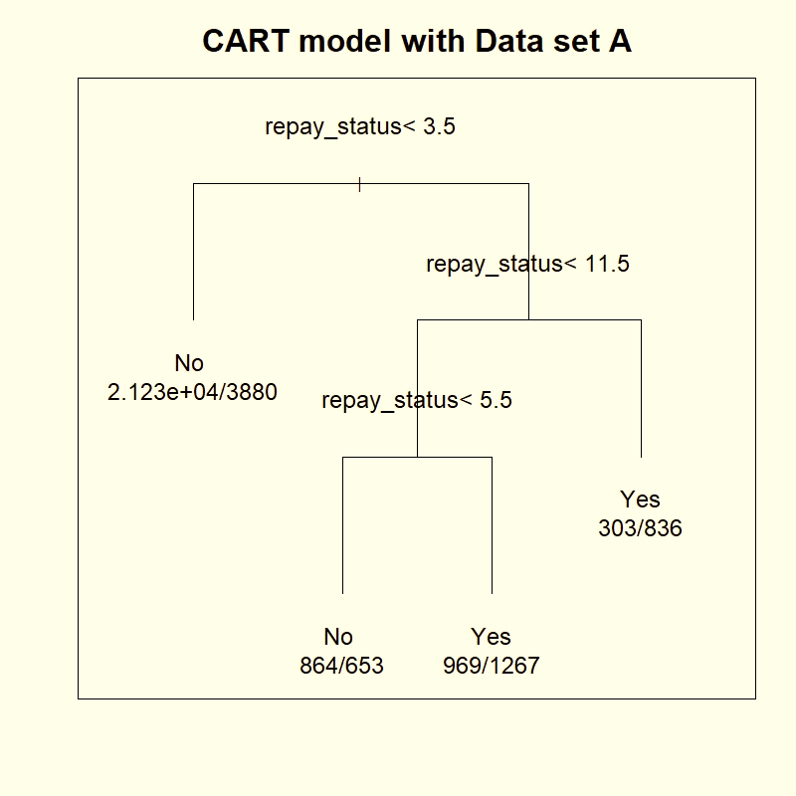
Introduction
• • • • •
SVM
• • • • •
CART
••••
Conclusion
• •
CART – Results
The repayment status (recoded)
is informative.
The third split performed
poor.
PART TWO
CART

Slide 18





Conclusion
Origin data: 77.88% (No) versus 22.12 (Yes)
SVM with linear kernel for Data set A: 80.37%
CART for Data set A: 80.46%
Depends on user!

Slide 19
Data quality
Data typing error
Lack of other features
Another classification approach
Final Discussion
Introduction
• • • • •
SVM
• • • • •
CART
••••
Conclusion
• •

